Slide 1
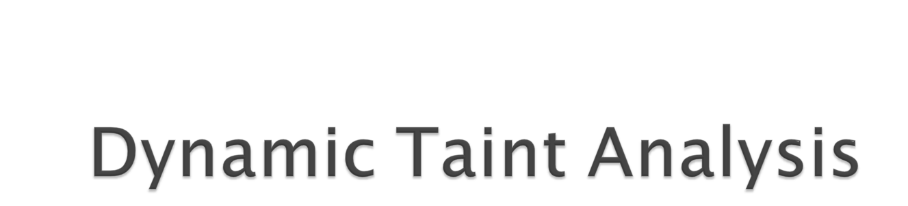
for Automatic Detection, Analysis, and Signature Generation of Exploits on Commodity Software
James Newsome (CMU) and Dawn Song (CMU)
(from the Network and Distributed Systems Security Symposium, February 2005)
Presented by Jaime H. Flores
Notes:
Acknowledgement: The diagrams that I am using (as well as some technical terms) are directly from the paper.

Slide 2
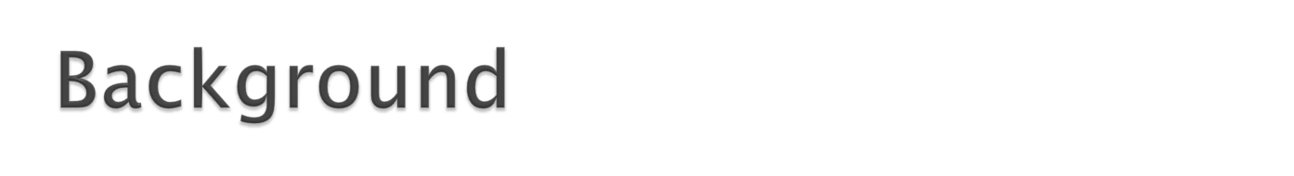
CodeRed and Slammer worms – simple attack mechanism, fast propagation
Manual response is not fast enough
Most effective solution: Automatic detection and defense mechanism
Notes:
Software vulnerabilities have had a devastating effect on the Internet over the last 15 years. Earlier this semester we saw how easy it is to perform a buffer overflow attack and saw how worms like CodeRed and Slammer were able to use that exploit to spread to hundreds of thousands of computers in just minutes. With that level of fast propagation speed, a manual response can’t materialize fast enough before millions of dollars of damage are done. The most effective solution for an attack like that is to have an automatic detection and defense mechanism.

Slide 3

Fine-grained detector
Few or no false positives or false negatives
Easy to deploy
Automatically analysis and signature generation
Notes:
This assumes a few things about the mechanism requirements however. First, it must be a fine-grained detector. What I mean by this is that it simply must detect the attack on a program’s vulnerabilities. The alternative to this is a coarse-grained detector, which generally scan a number of ports looking anomalous connections or behaviors. The problem with this alternative is that most of the time, the attack needs to occur successfully for before the weird behavior starts occuring, and by then, it’s too late. _x0010_The second requirement for this mechanism is that number of false positives and false negatives is kept low, preferably at zero, because you don’t want to inadvertently create a defense mechanism for what would be legitimate behavior of the program, nor do you want to accidentally let a program get exploited. Another requirement is that the mechanism must also be easy to deploy; we’ve already seen a number of other defenses available for software like StackGuard, but these require you to recompile the program or to add special code to the program, and a lot of times that’s hard to do and expensive. _x0010_The last requirement for this mechanism is that it must be able to not only detect and stop the exploit; it needs to be able to analyze it and create the filter or signature necessary to defend against future attacks, at least until a patch can be written to fix the vulnerability.

Slide 4
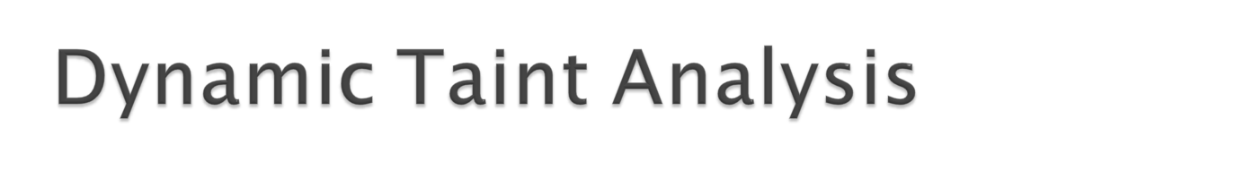
A new approach as well as a tool (TaintCheck)
Marks untrusted data as tainted
Follows data through the life of program
When tainted data is used in a bad way, analyze the exploit and creates a defense
Notes:
With these requirements in mind, the authors developed an approach they call dynamic taint analysis, along with a tool called TaintCheck that implements this approach. The approach is simple: it marks input or data that comes from untrusted sources or data that is arithmetically derived from an untrusted source as tainted. Then it will keep track of the data throughout the life of the program and detects if the data is used in an exploiting manner. This approach specifically targets attacks that overwrite data in memory, like the buffer overflow attack we did for the first project. Overwrite attacks are the most common type of attack that is usually seen with the type of malware we are aiming to defeat. Once the attack is detected, the tainted data and its markers can be analyzed to create a signature or filter to defend against this attack further.

Slide 5

Works with already compiled and proprietary software
Successfully detected most overwrite attacks
No known false positives
New signature creation approach: semantic analysis based signature generation
Notes:
The tool that the authors developed meet all the requirements that were set forth before. The software worked with off the shelf software (gcc, latex, vim, make, apache, cfingerd, and bzip2, which were used to test the performance of the tool). In their testing, they performed a number of different attacks, which TaintCheck detected all successfully, but they did figure out certain cases (false negatives) where it does fail which I’ll explain briefly later. For the defense mechanism, they developed a new method for creating signatures based on semantic analysis of a detected attack.

Slide 6

Prototype: runs on Valgrind as an extension
Based on observation from how overwrite attacks work
Shadow memory pointing to taint structures
Notes:
The prototype version of TaintCheck runs as an extension of Valgrind, the popular open source x86 emulator commonly used to find memory problems in software. The way the TaintCheck approach works is based on the idea that an attacker needs to alter some normal value or data of the program in order to execute it’s attack. For this reason, TaintCheck maintains a shadow memory mapped to each byte of data. This shadow memory points to taint structures, which are used to store information about where that data originated and how it propagates through the program.

Slide 7
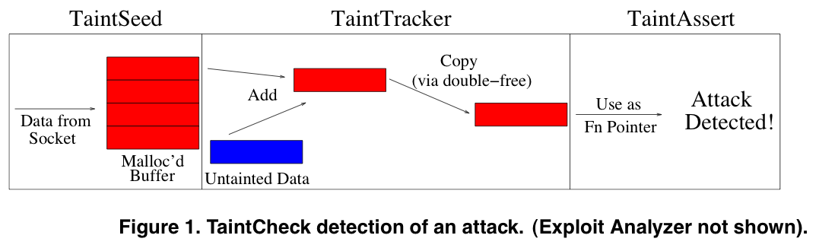
Notes:
TaintCheck works in 4 stages. During each operation, it firsts checks to see if any data being produced or allocated is coming from an untrusted source, usually a network socket or from user input. It will then mark the entire memory block as tainted, creating a taint structure for that memory. As the program continues execution, it tracks to the memory and it’s associated taint structure through it’s propagation. The program then looks for any operations that use the data in what could be a malicious fashion. An example of this would be a jump call that is using an address inside a tainted memory block. Another example would be, as shown in the picture, calling a function pointer from a tainted memory block. _x0010_Fourth stage happens once malicious behavior is detected; the program then will use the taint structures to backtrack and see where the data first originated and how it propagated. From there, it can perform a semantic analysis on the structure of the memory or code calls that set up the attack and for a signature. A simple idea of this would be to scan a memory buffer that was passed in and use the first part of it that memory buffer as the signature. If any other memory blocks are given to the program that match that signature, it then knows its that particular exploit and handle it accordingly.

Slide 8
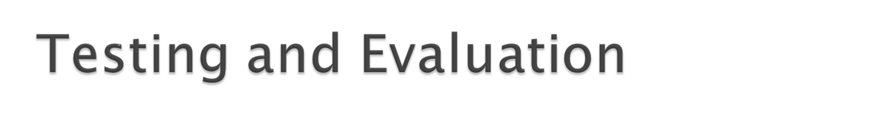
Testing bench: ATPhttpd, bftpd, cfingerd, gcc, ls, bzip2, make, vim, emacs, and bash
Detection of attacks
  3 synthesized exploitable programs (just like the ones we saw in class)
  3 actual exploits (on the server programs)
Performance
  A CPU-bound test, a short-lived process test, and an average test
  Compared to native speed, Nullgrind, Memcheck, and TaintCheck
Notes:
The testing of TaintCheck consisted of various server and client programs. The first 3 shown on the slides are the server programs: a web server, an FTP server, and a finger daemon. The client programs should be pretty familiar to the rest of you. The evaluation was done on two fronts: detection of attacks, and performance of programs running in TaintCheck. For the detection of attacks, they used the 3 server programs along with 3 synthesized programs that were exactly like the ones Dr. Zou showed us in class. For performance, 2 worst case scenarios and 1 average scenario was looked at, each one being run at native speed, then in Nullgrind (an extension of valgrind that does nothing), Memcheck (the default extension for valgrind), and TaintCheck.

Slide 9
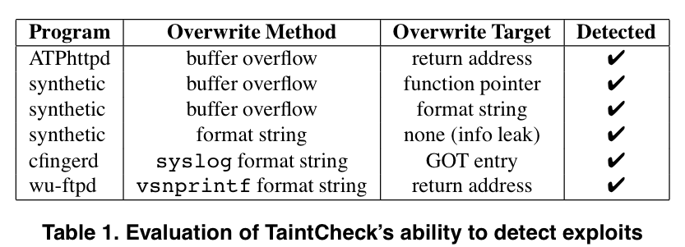
Notes:
These are the results for the detection of attacks. As I said before, programs used for testing were 3 synthesized ones and 3 actual ones. The 3 synthesizes consisted of a buffer overflow attack on a program using the gets(), another buffer overflow attack which overwrote a function pointer, and a format string attack simply to leak info from the stack. For the servers, the vulnerabilities consisted of a buffer overflow attack like we did in project 1, a format string that ultimately causes a function pointer to get overwritten, and another format string exploit which is overwrite a return address. In all cases, TaintCheck was able detect both the exploit and the source input for the exploit.

Slide 10
CPU-Bound workload: bzip2
  37.2 times longer on TaintCheck
  13.3 times longer on Memcheck
  3.1 times longer on Nullgrind
Short-lived process : cfingerd
  36 times longer on TaintCheck
  32 times longer on Memcheck
  13 times longer on Nullgrind
Common case: Apache
  Depended on the server queries, mainly if it was CPU or I/O heavy
Notes:
If anyone has used valgrind before, these results shouldn’t be too surprising. Because valgrind is emulating the code, it is actually rewriting and retranslating the code it process into x86 instructions. That process takes on a lot of overhead, and in these 2 worse case scenarios, the performance hit is very apparent. In the case of Apache, the performance depended on how much CPU a query required, which makes sense given how on a CPU bound workload, the program ran 37.2 times longer.

Slide 11
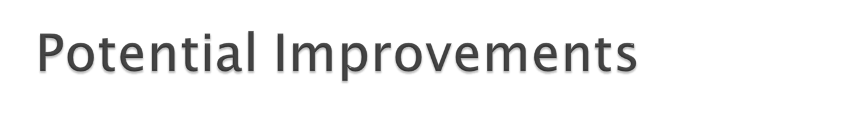
Performance needs the most improvement
Different base emulator – DynamioRio
  Much faster and much more optimized than Valgrind
Static analysis of blocks to eliminate redundant information
  Preliminary implementations shows only a 24x speed hit with bzip2 (instead of 37x)
Overhead will always be an issue
Notes:
The main area for improvement with TaintCheck is performance. In a lot of cases, the best place to run TaintCheck might be on a server to protect it against malicious attacks. However, servers generally can’t suffer such hi performance hits which makes this impractical. The authors however found an alternative to valgrind called DynamoRio which is a much faster and more optimized equivalent, and building TaintCheck on it should yield a significant improvement. Beyond a different emulator, some changes to how TaintCheck marks and stores information would help lower overhead since less redundant information would be generated. Preliminary implementations already show a significant improvement. Despite all this however, because programs are being emulated ultimately, performance will always be an issue.

Slide 12
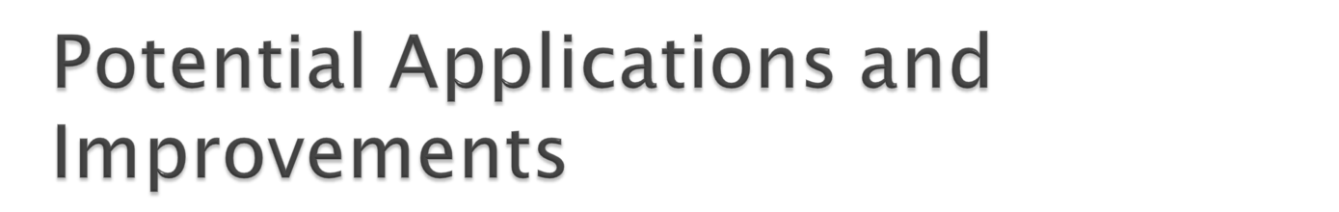
Used to detect new attacks
  Semantic data and samples can be passed on to other systems
  Signatures can be created from a sampling of this semantic data
Sandbox for worm/exploit sampling
Classification of vulnerabilities
Signature verifier
Notes:
There are a number of potential applications and improvements the authors discuss. The most obvious application is for detecting new attacks. With it’s built in signature generation, it can detect an exploit occurring, and forward the signature plus additional data to a separate system to verify and propagate the signature to other systems. A second application is to use TaintCheck as a sandbox; a worm for example could be forced to attack protected software. TaintCheck would then detect the exploit, then let the exploit run, but preventing any real output from the machine. It would log all the data coming out of the system and use it to generate a more accurate signature and to provide the information to the systems. A third application Is for classification of vulnerabilities. TaintCheck can already detect a number of various details of exploit, in particular the method of the exploit and the data used for the exploit. With additional sophistication, it can classify an exploit based on this information and feed it to exploit databases that can then be distributed to other systems. One final application the authors discuss is the potential for signature verification. A new signature could be given to TaintCheck for it to use to detect a new vulnerability. Depending on how effective TaintCheck is at detecting the exploit with the signature, a new one could be generated by TaintCheck based on what it gathered from the given key and from the exploit themselves.

Slide 13
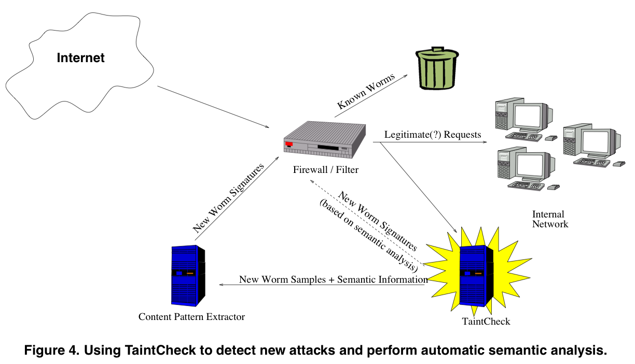
Notes:
I will be using this slide as a reference for the previous slide mostly.

Slide 14

Innovative approach
An effective counter to future CodeRed and Slammer like worms
Versatile platform
Notes:
The major contribution of this paper is the proof of concept aspect, showing a new innovative approach, and how effective this approach can be. Other systems can be just effective, but require code changes or recompiling of existing software or just flat out aren’t as reliable. And such a simple approach lends itself to being not just a program, but a versatile and flexible platform for future use with software vulnerability analysis.

Slide 15

Very well written paper; only one problem:
Lacked depth or details in some areas
Notes:
This paper was exceptionally well written so it was hard to pinpoint a particular weakness. The one issue that stood out however was that some topics were answered very vaguely and with no real depth into the subject, unlike some other sections of the paper.

Slide 16
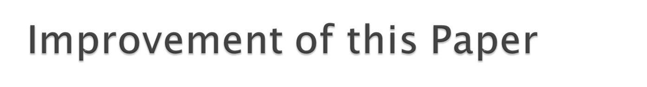
Extension: Faster, better TaintCheck
  The other potential applications and improvements aren’t practical until the performance overhead is minimized to acceptable levels
Notes:
To improve this paper, I would like to see an extension or follow up on this subject that implements and presents a more efficient TaintCheck. None of the other improvements or applications seem practical without having TaintCheck run quickly without so much overhead.

Slide 17
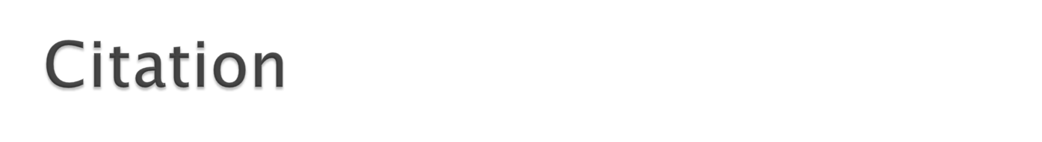
Newsome, James and Dawn Song. "Dynamic Taint Analysis for Automatic Detection, Analysis, and Signature Generation of Exploits on Commodity Software." Proceedings of the Network and Distributed System Security Symposium (NDSS 2005). 2005.

Slide 18

Thanks!

